Slide 1

BUBBLE BOMB BEAUTY
CSIT 337 FINAL PROJECT
PHP SQL website of beauty supplies.
Team leader-Kelsie Laducer
Members- Cassie Ihekwaba, Allison Llanos, Catherine Thaureaux

Slide 2
Website: Bubble Bomb Beauty
Bubble Bomb Beauty is an ecommerce website that sells natural cosmetic products such as scrubs and soaps.
On this website users can view explore the selection of products available on the home/products page
View the details of the product and read more about the product as well as view the price
Additionally, users can add to cart or return to the home/products page

Slide 3
Website: Bubble Bomb Beauty
On Bubble Bomb Beauty users can: explore, view, add products ,and proceed to checkout to finalize their order.
On the admin side of our website the admin can : delete products, insert products, search for products, and logout.
To insert products: type in the necessary details for Product Name, Description, Price, and image. Once these fields are filled out the admin can click add product.
To delete products: Enter the correct product ID associated with the item the admin wishes to delete.

Slide 4
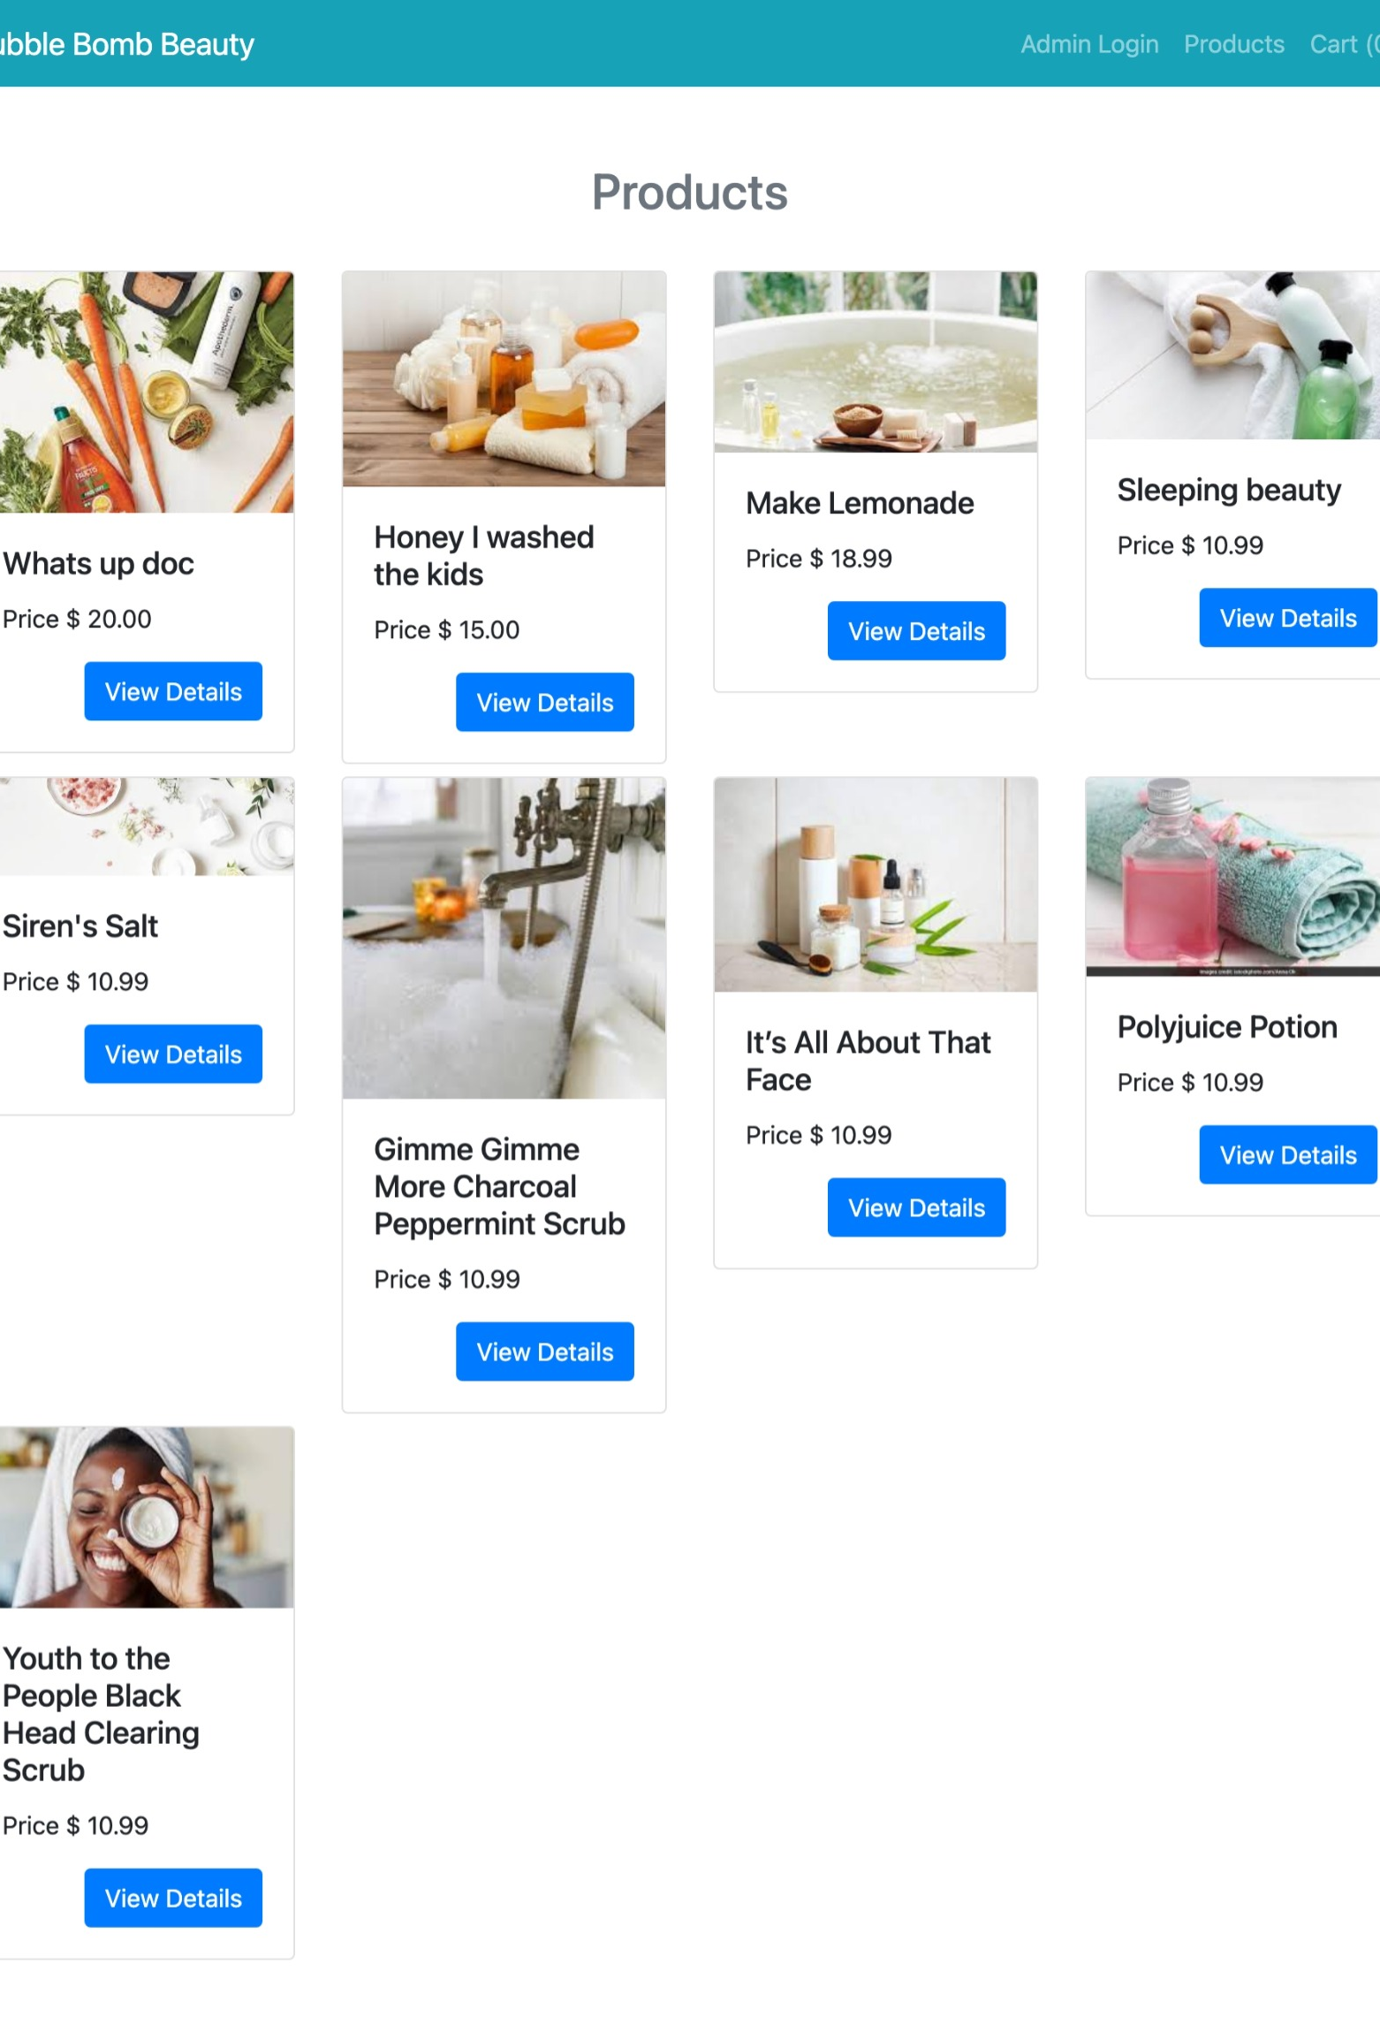
Technologies
To create our website, we used the following technologies: html, css bootstrap, php, and MySql database.

Slide 5
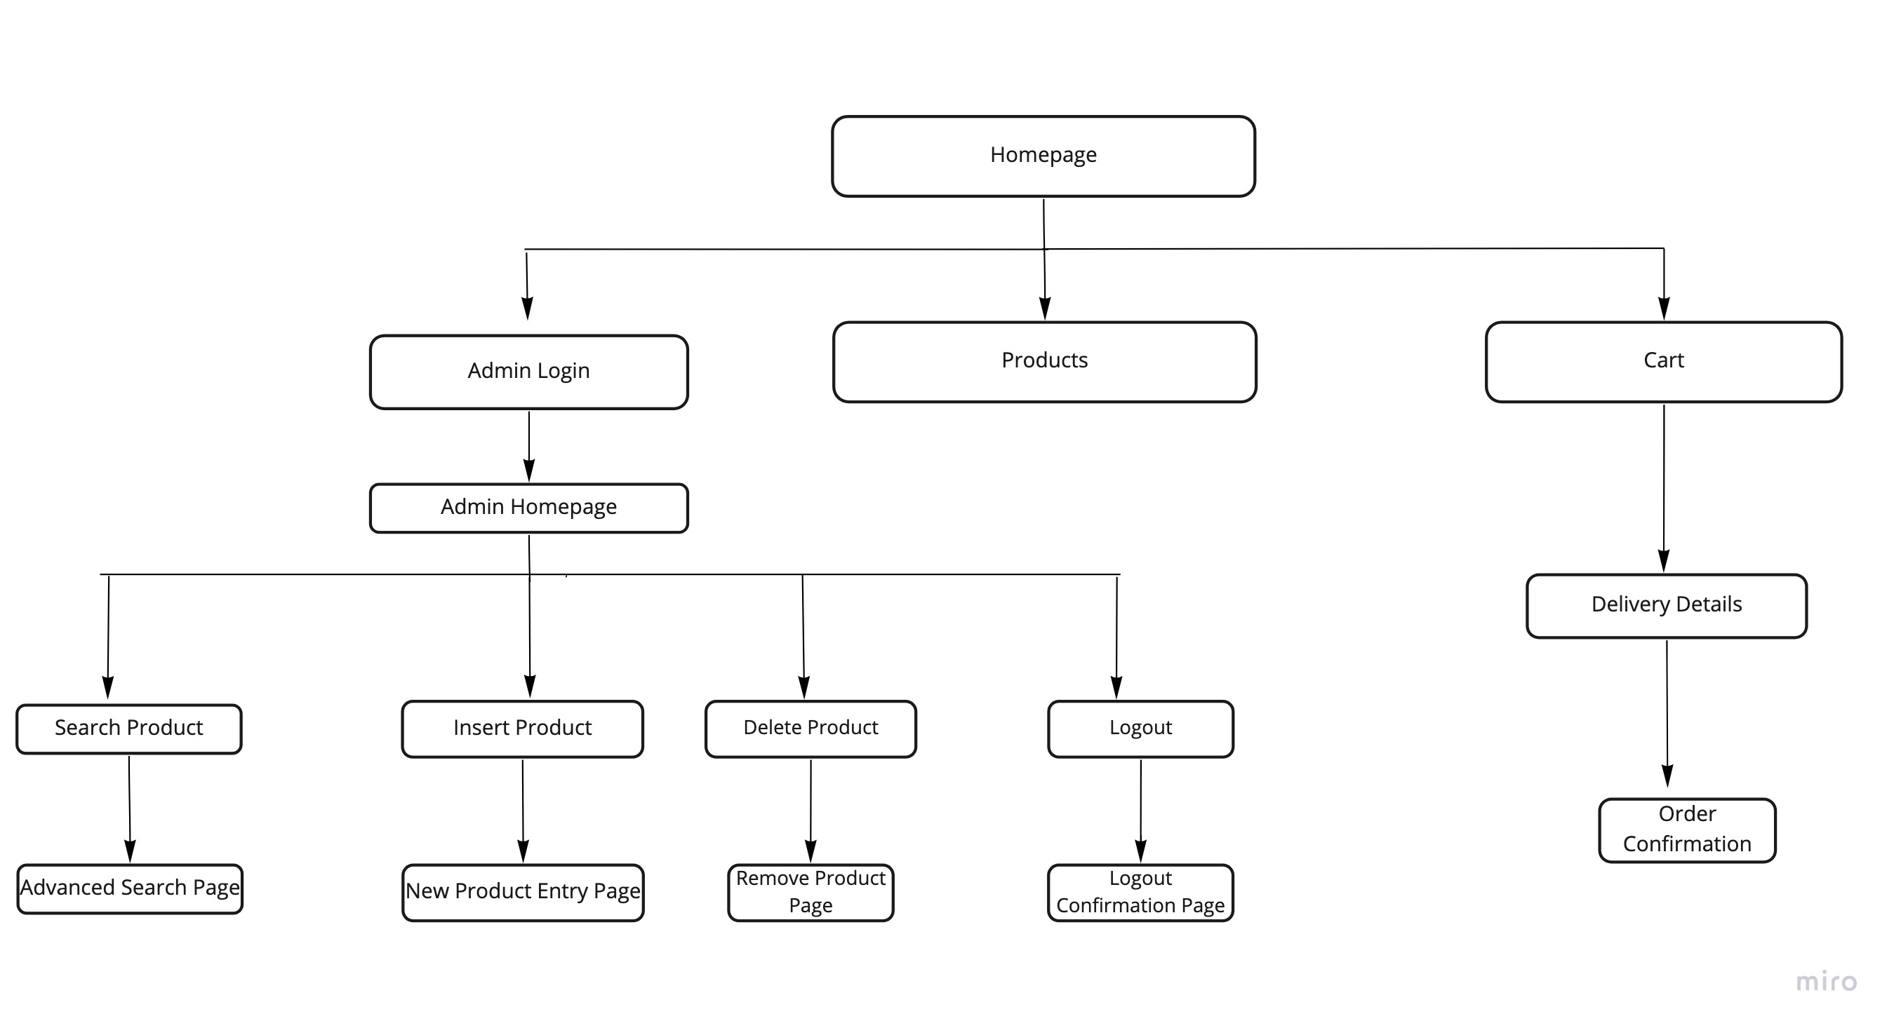
Website Architecture

Slide 6
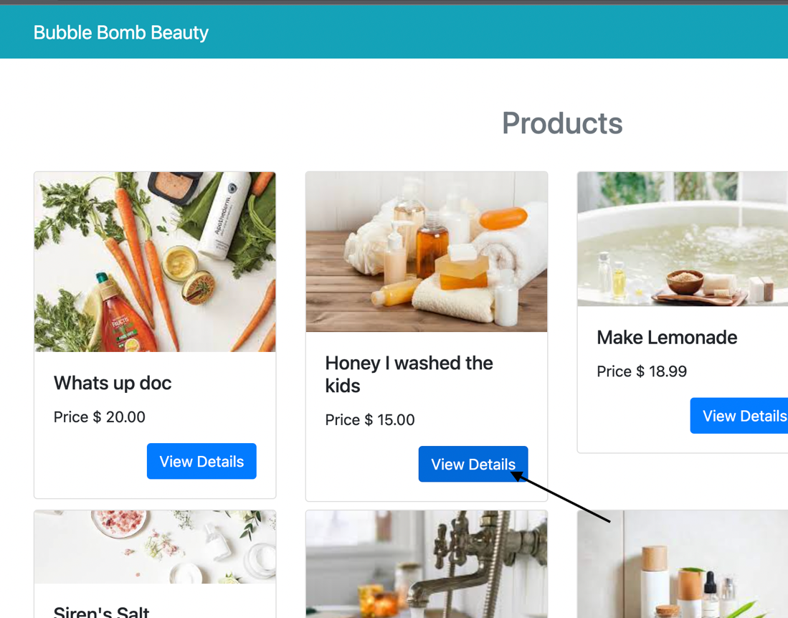
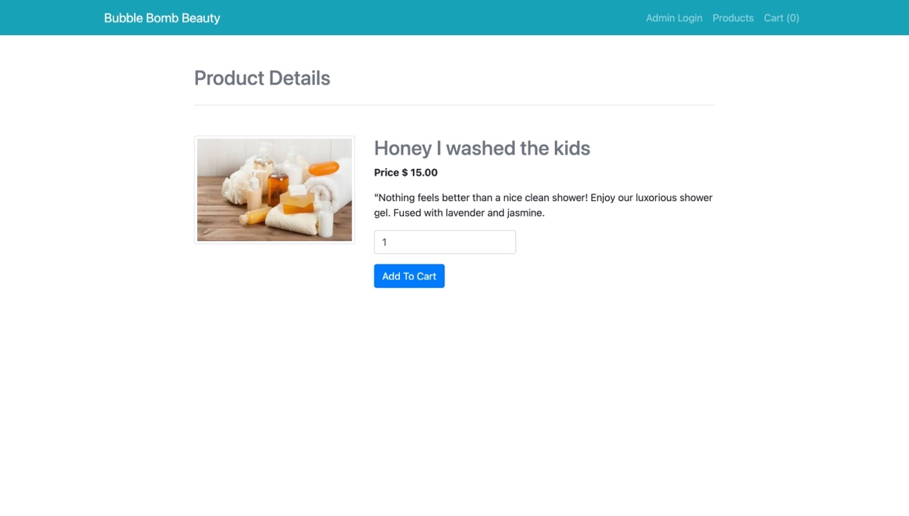
Website Features: View Details
On Bubble Bomb Beauty users can click View details to see the pricing information and decide if they want to add to cart.

Slide 7
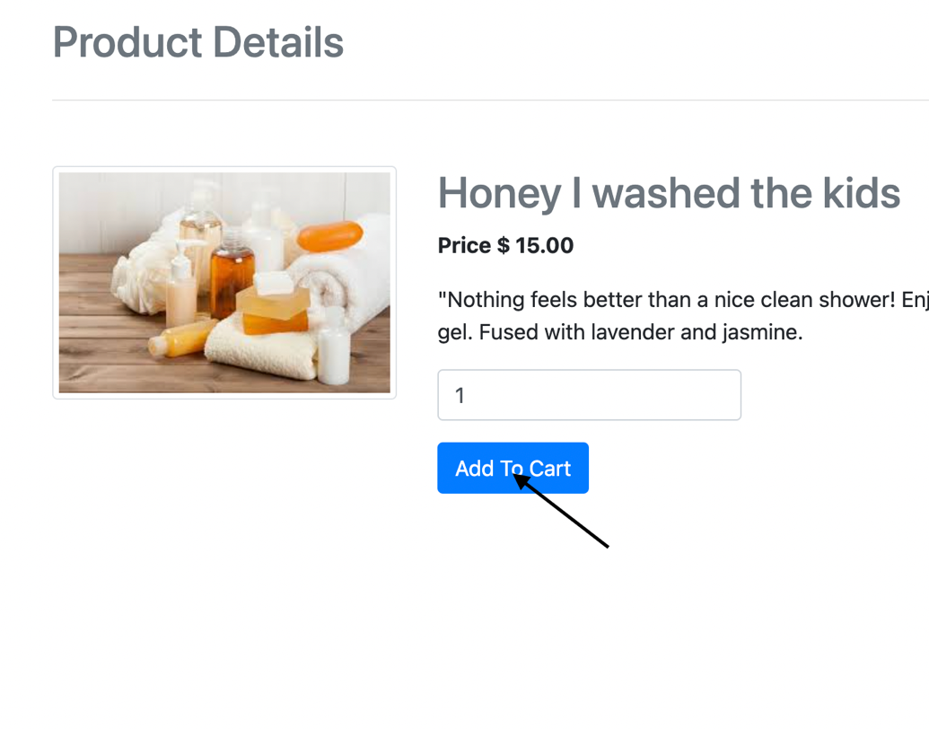
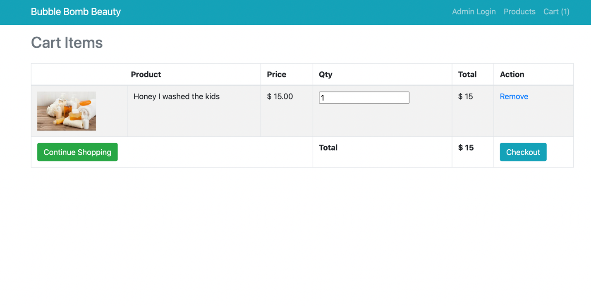
Website Features: Add to Cart
On Bubble Bomb Beauty users can add the products they want to purchase to their cart.

Slide 8
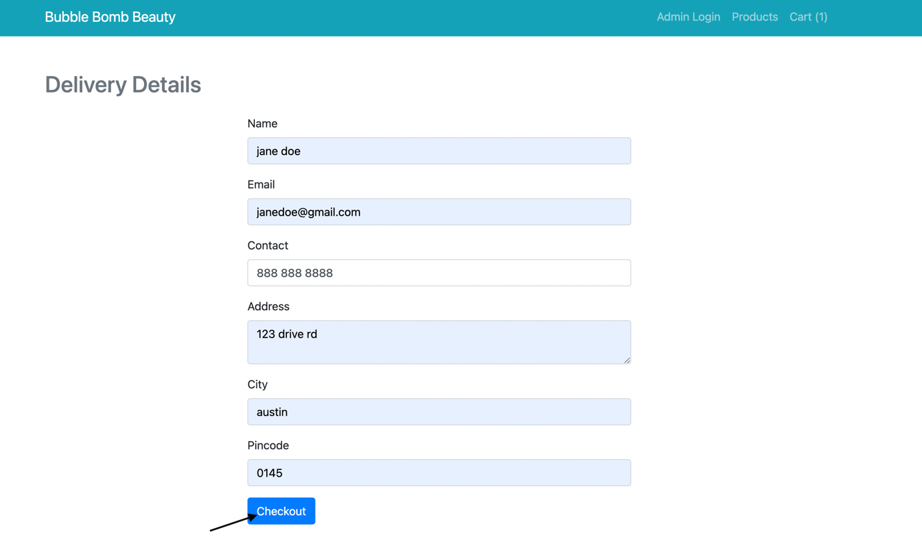
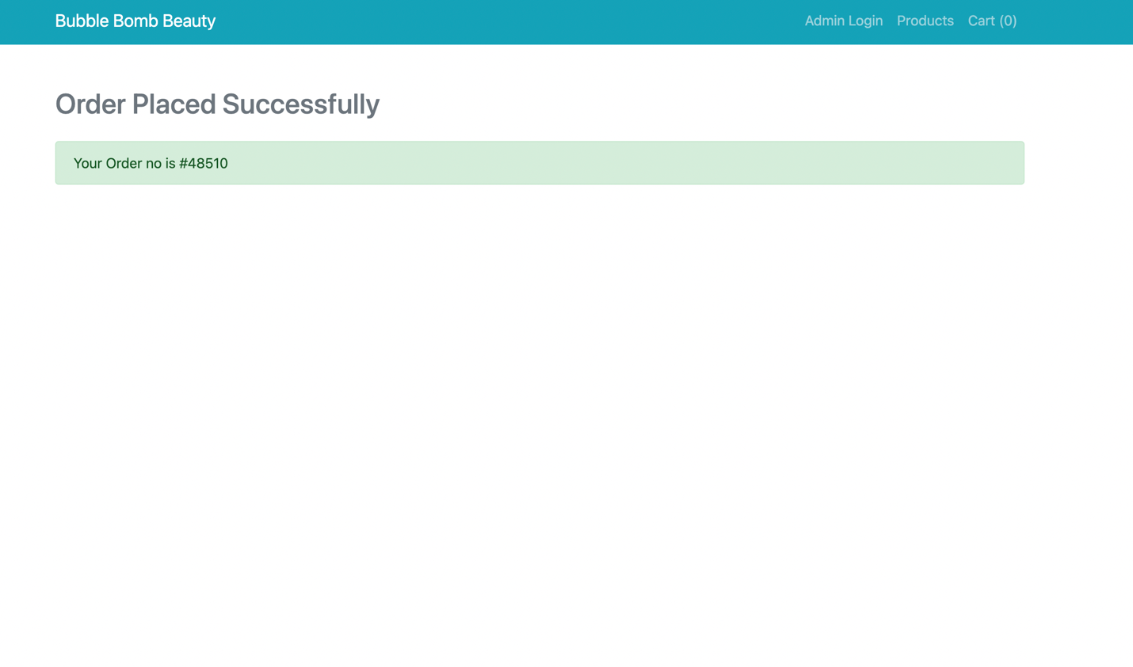
Website Features: Checkout
On Bubble Bomb Beauty users can checkout and successfully place their order.

Slide 9
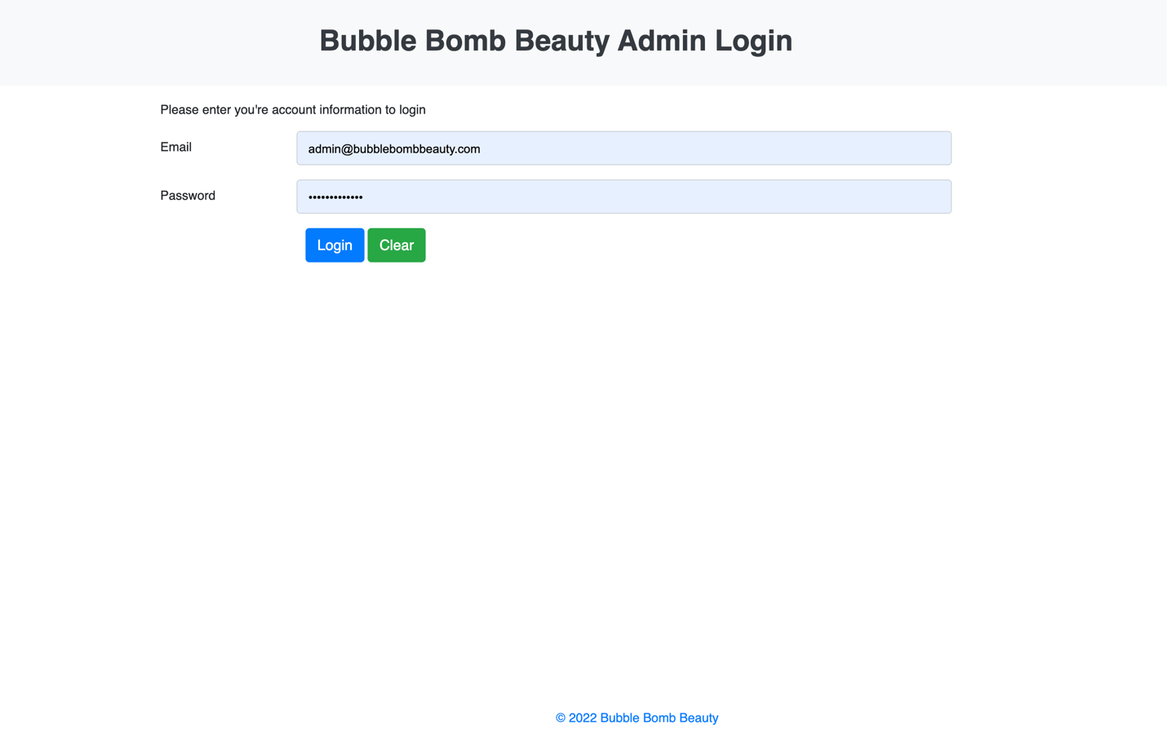
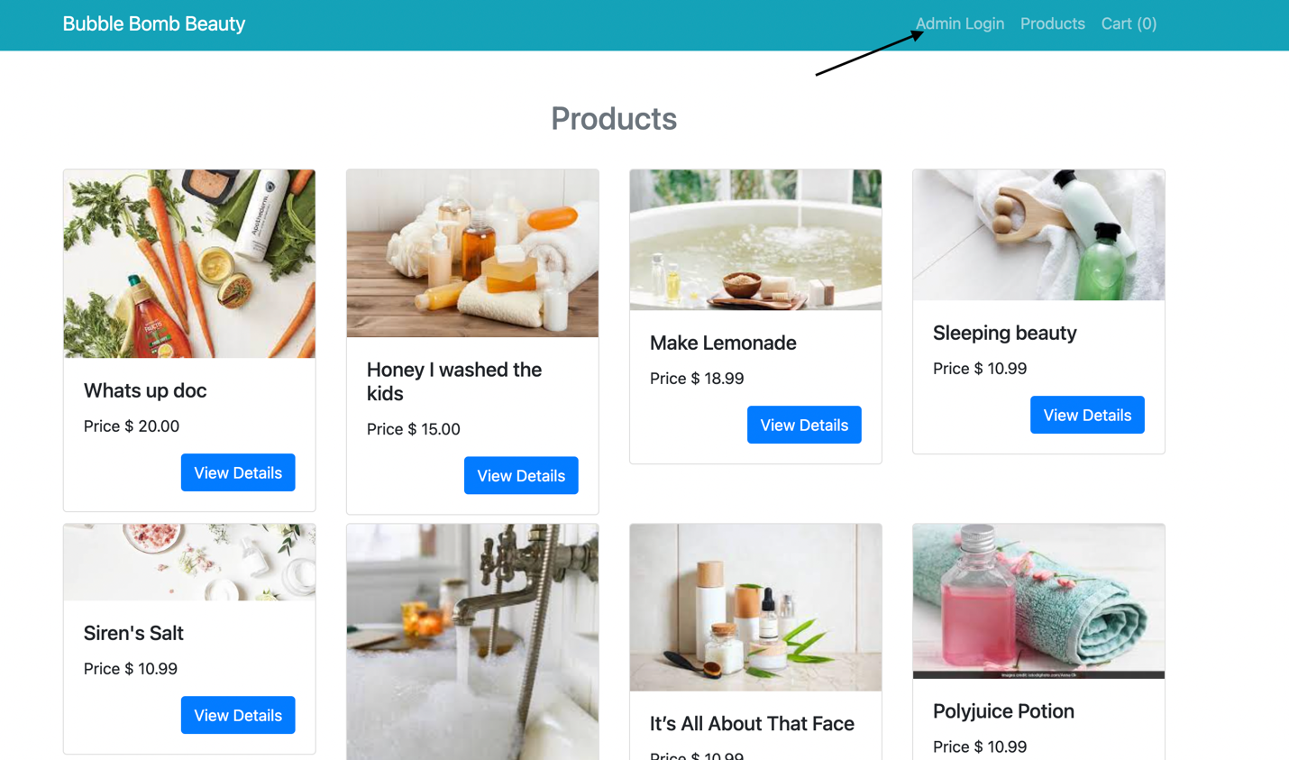
Website Features: Admin Login
On Bubble Bomb Beauty the admin can successfully login into the administrator side of the site.

Slide 10
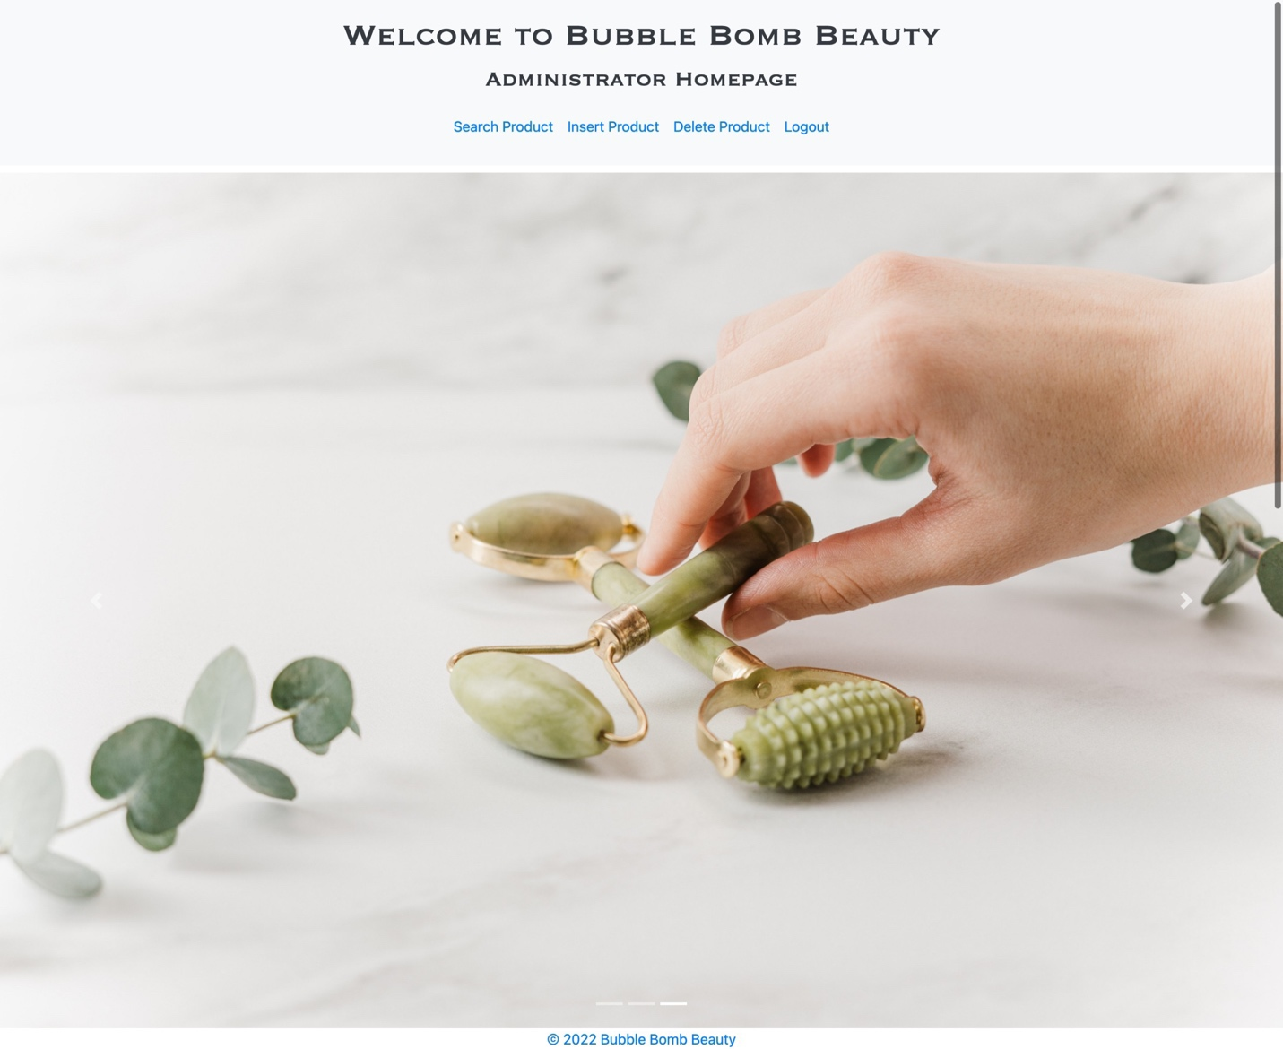
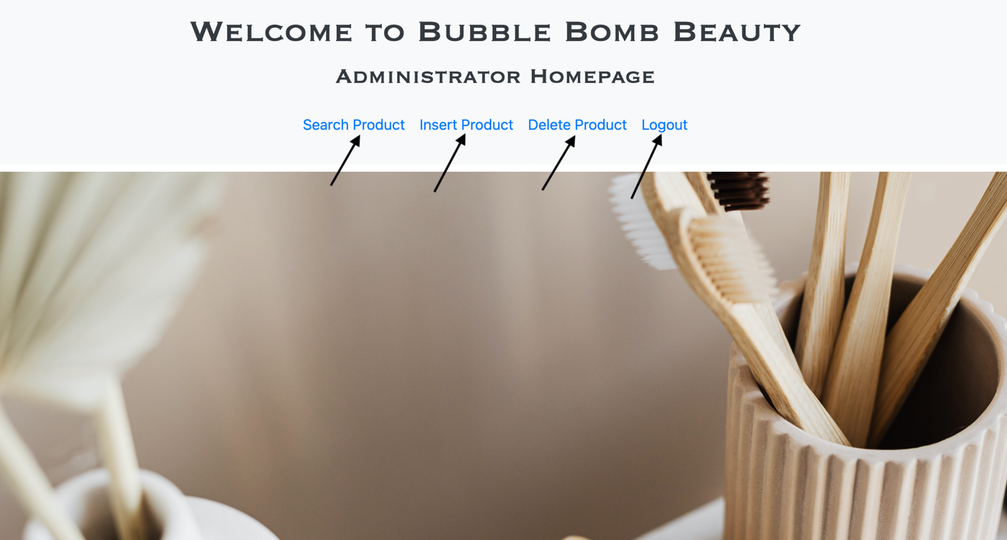
Website Features: Admin Page
On Bubble Bomb Beauty once logged in the admin had access to the admin page which is home to the following feature: Search Product, Insert Product, Delete Product, and Logout.

Slide 11
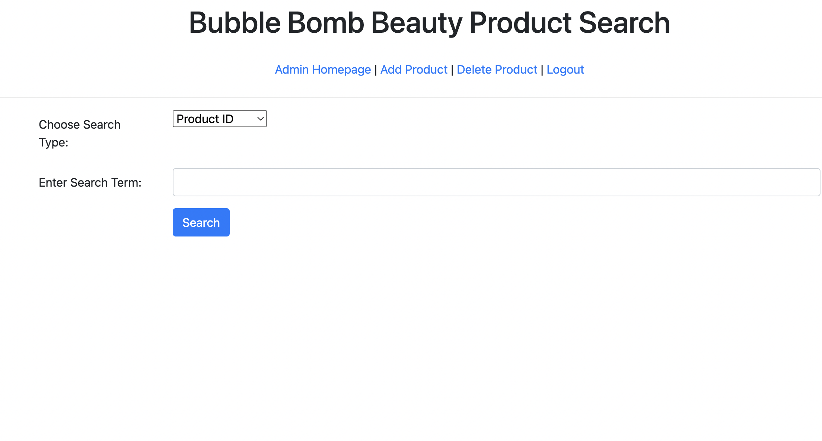
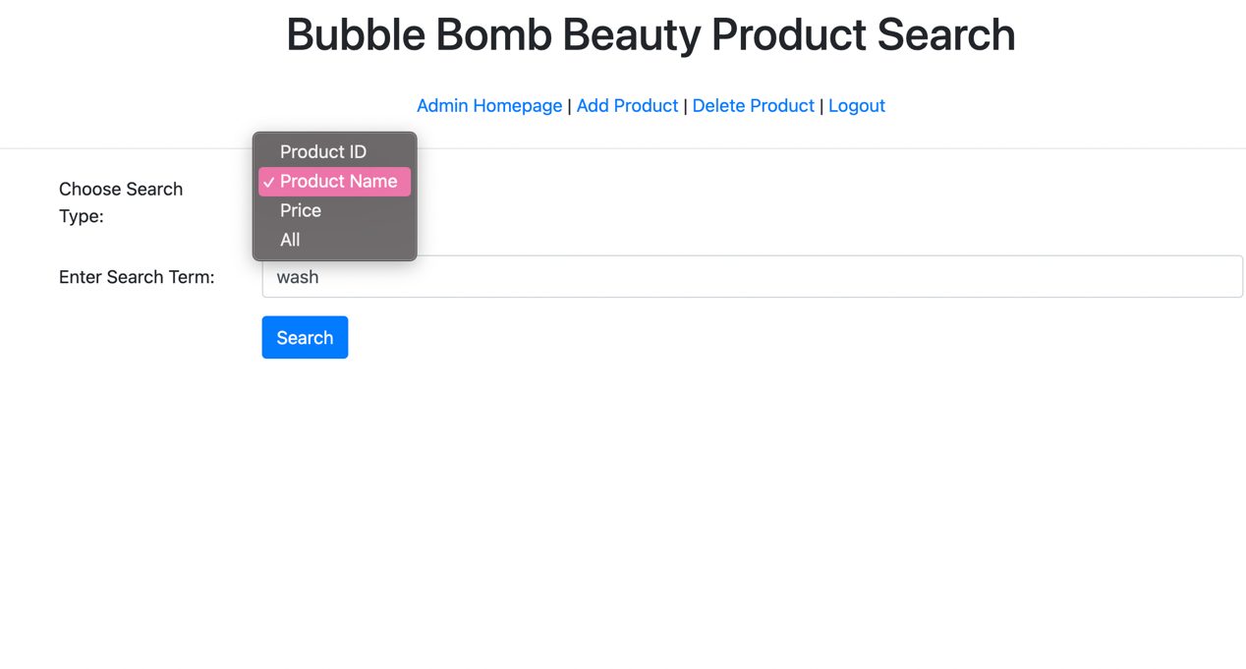
Website Features: Admin Advanced Search
On Bubble Bomb Beauty once logged in the admin can use the advanced search to look up various products to mange the stock available.

Slide 12
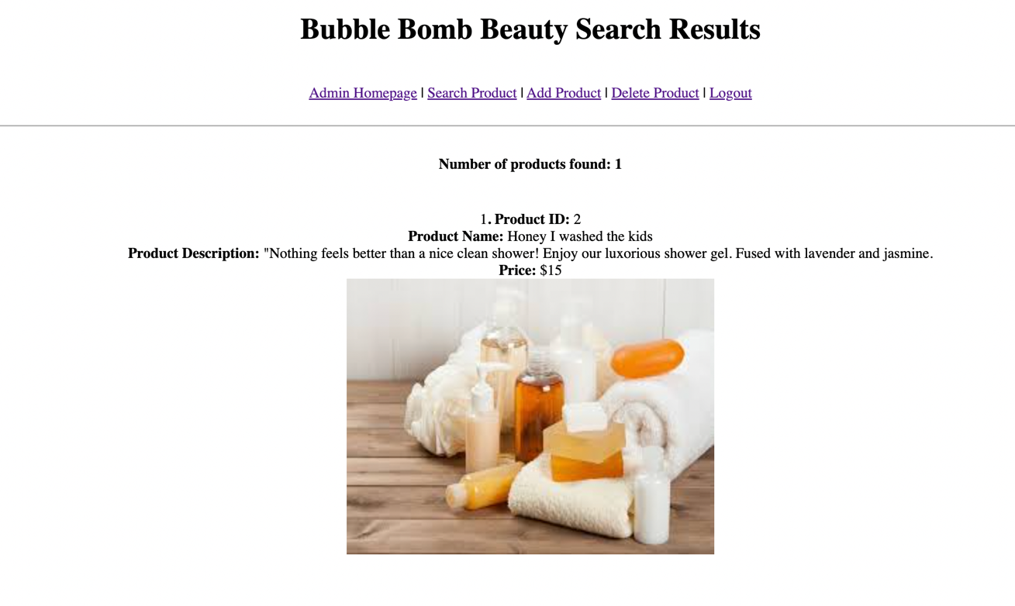
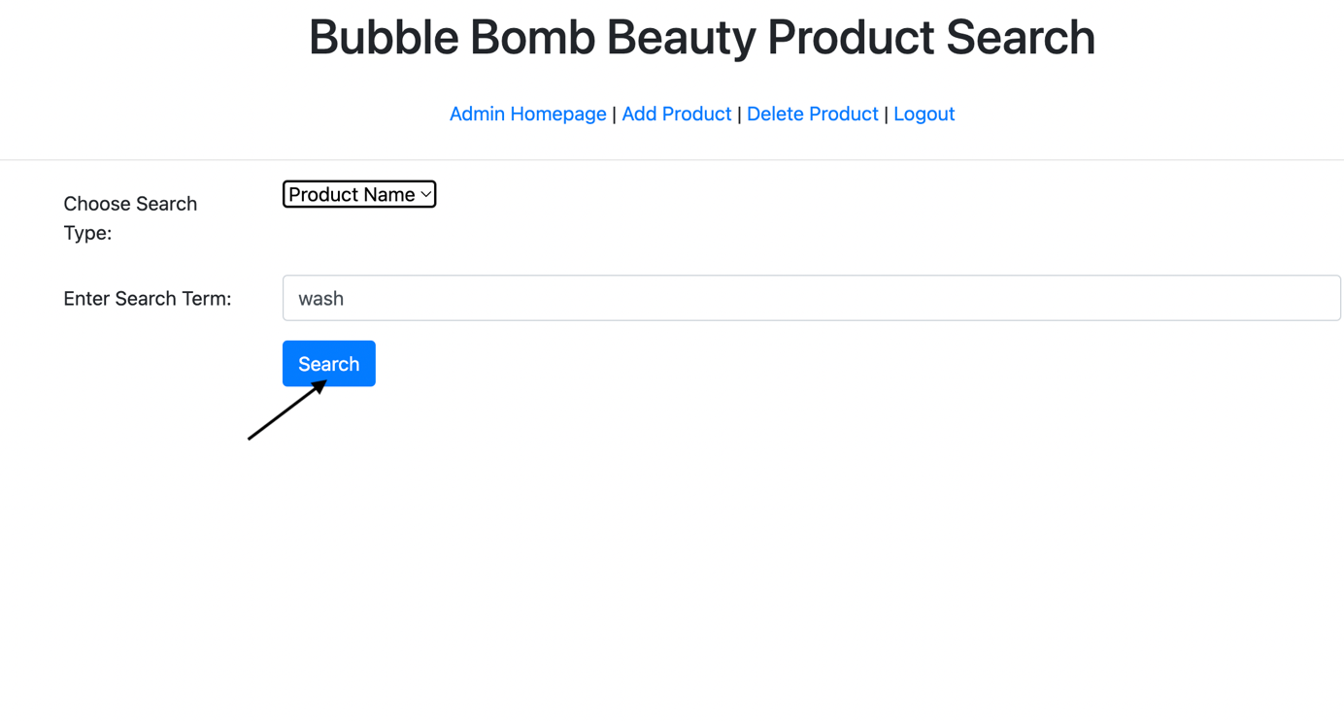
Website Features: Admin Advanced Search
The Admin side of the site can successfully generate various search results related to the search inquiry.

Slide 13
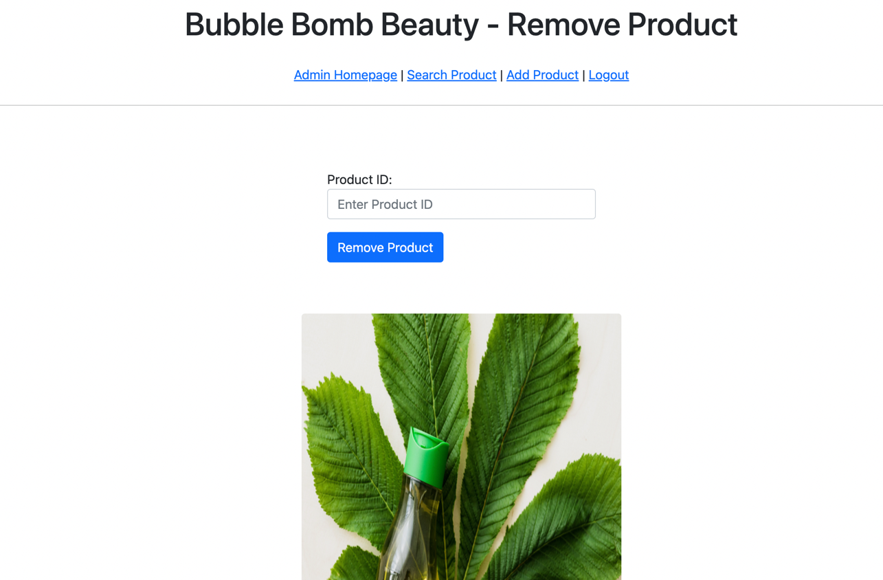
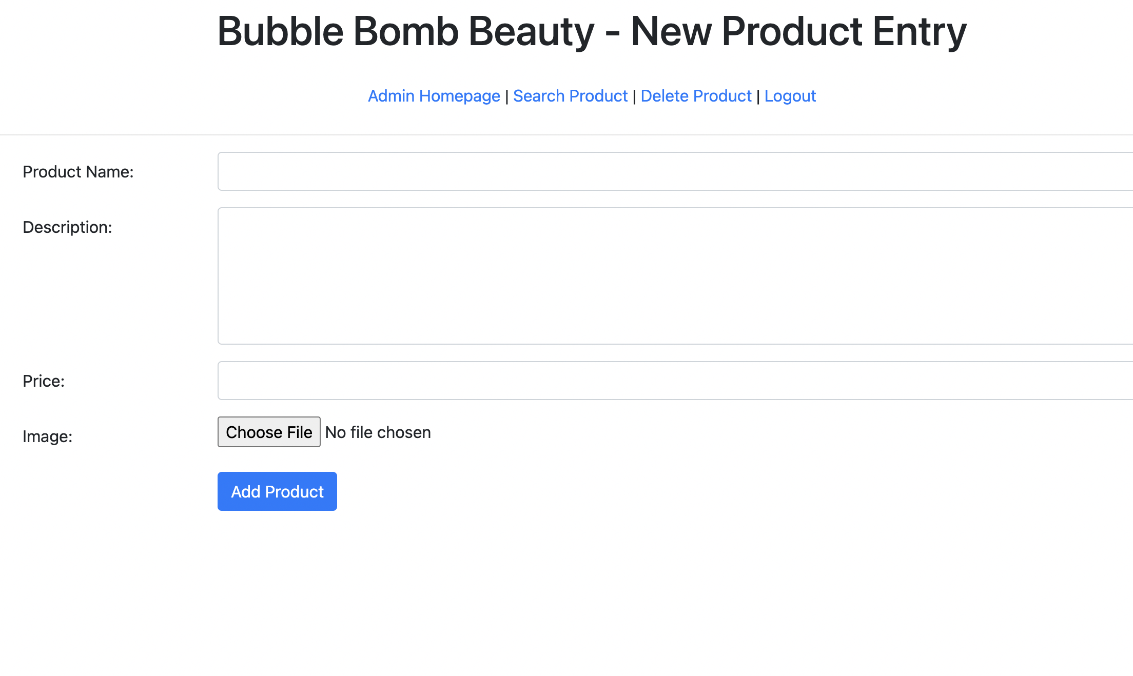
Website Features: Admin Add or Remove
The Admin side of the site can successfully insert and remove products with ease.

Slide 14
Pending Website Features
Overall, we were able to create a functional e-commerce website that allows users to make a purchase successfully. As well as a fully functional admin side.
Some features that we were unable to incorporate include: a product navigation bar with drop down categories and more elaborate features on the administrator side. These features with more time could have been incorporated into our already functional website for a more user friendly experience.

Slide 15
YouTube Video Link
https://youtu.be/y5HZKjab8PU

